Slide 1
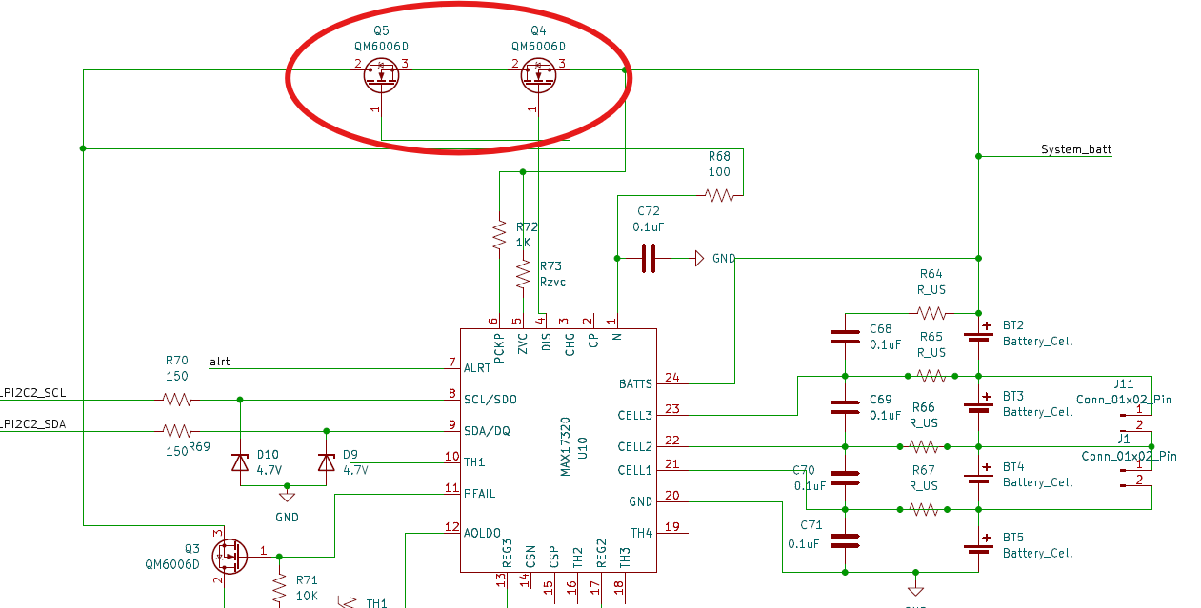
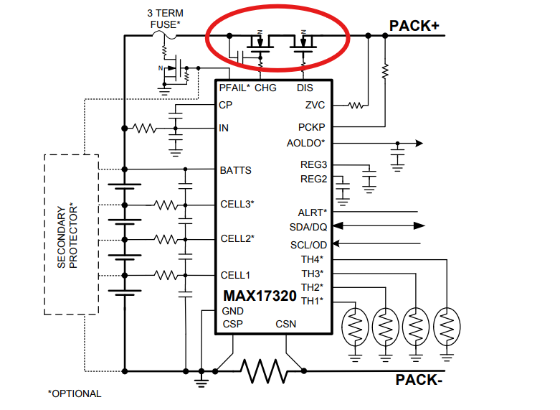
MAX17320 schematic concern #1
Back-to-back mosfet is required in MAX17320. It should be in opposite orientation like following. The MOSFET circuit is a load switch application, and block the current is bidirectional

Slide 2
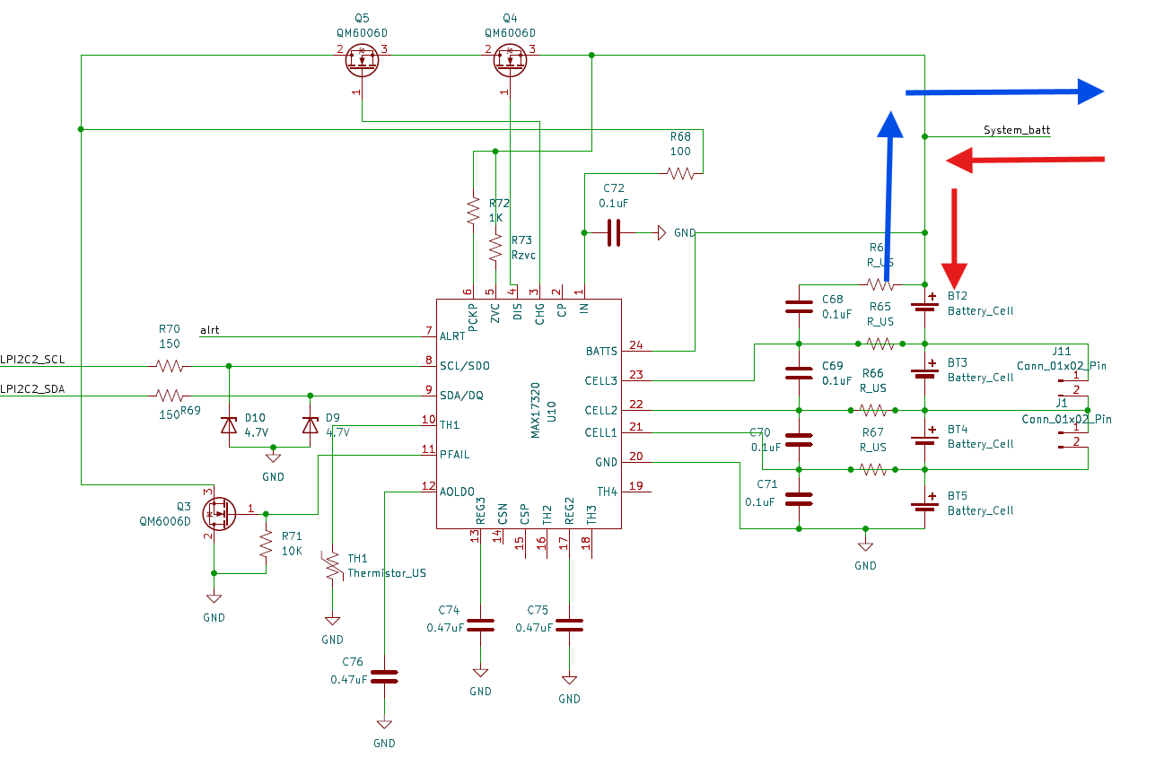
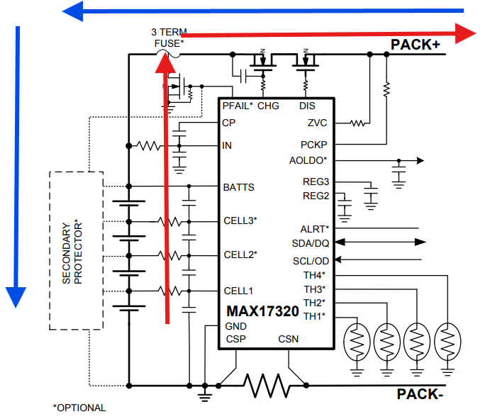
MAX17320 schematic concern #2
I notice that your battery input is directly flowing to the battery pack. It does not go through MOSFET circuit. Therefore, it will not have the load switches feature between charger and battery.

Slide 3
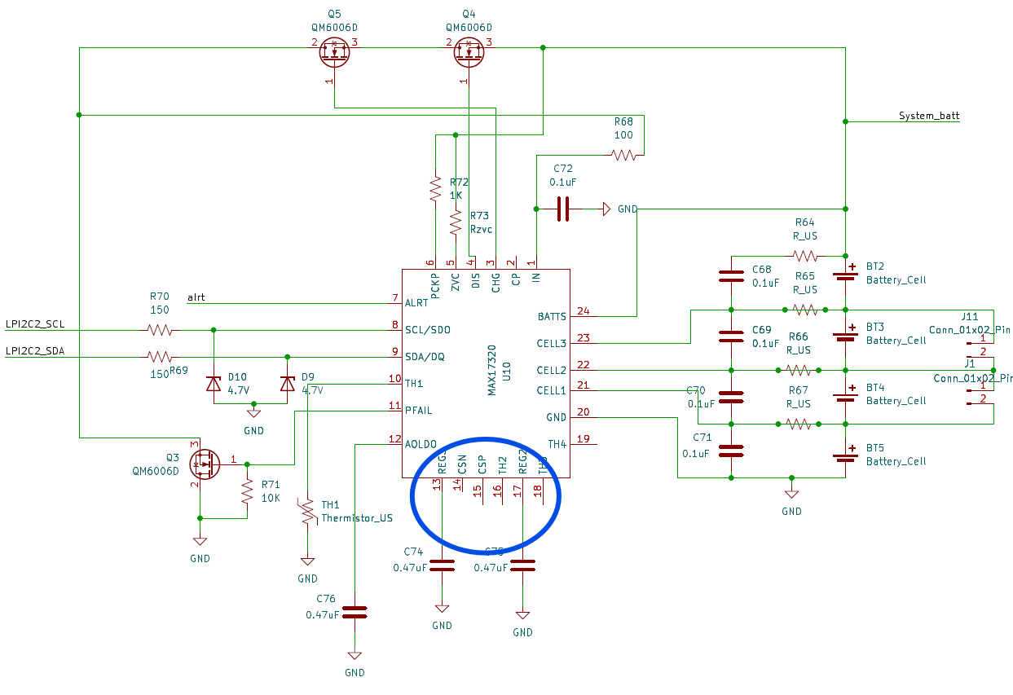
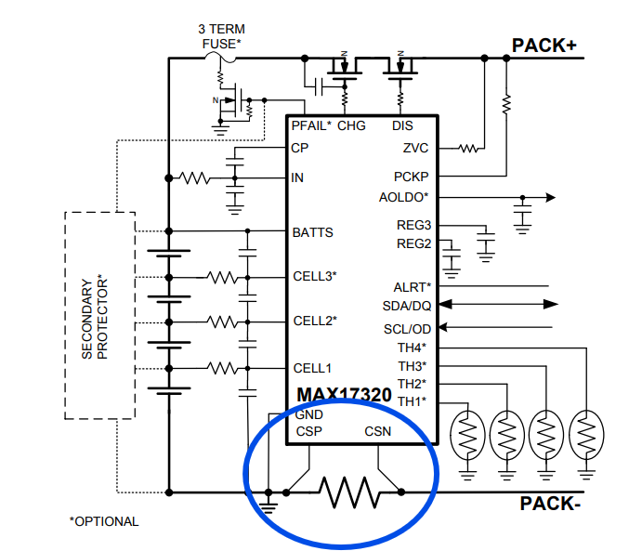
MAX17320 schematic concern #3
your CSP and CSN is not in use. Does not have the current sense resistor. It will affect and not able to perform the fuel gauge feature.

Slide 4
New Proposal to power tree
24V
LTC4162-L
MP2759
16V
MPM3620
MPM3620
MAX17320
Li-ion cell x2
MAX42402
MAX42402
Li-ion cell x2
Li-ion cell x2
3.3V
5V
Li-ion cell x2

Slide 5

MAX42402/MAX42403/MAX42405/ MAX42406/MAX42408/MAX42410
https://www.analog.com/media/en/technical-documentation/data-sheets/max42402-max42403.pdf
https://www.analog.com/media/en/technical-documentation/data-sheets/max42405-max42406.pdf
https://www.analog.com/media/en/technical-documentation/data-sheets/max42408-max42410.pdf
36 V Monolithic Buck Regulators, 2.5 A to 10 A

Slide 6
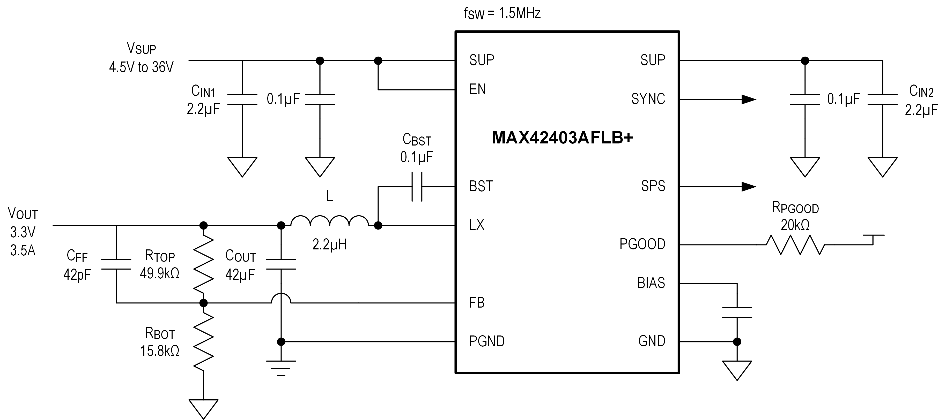
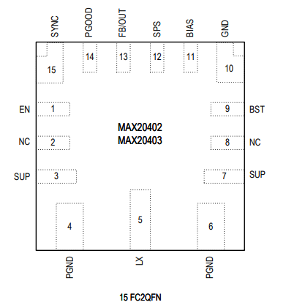
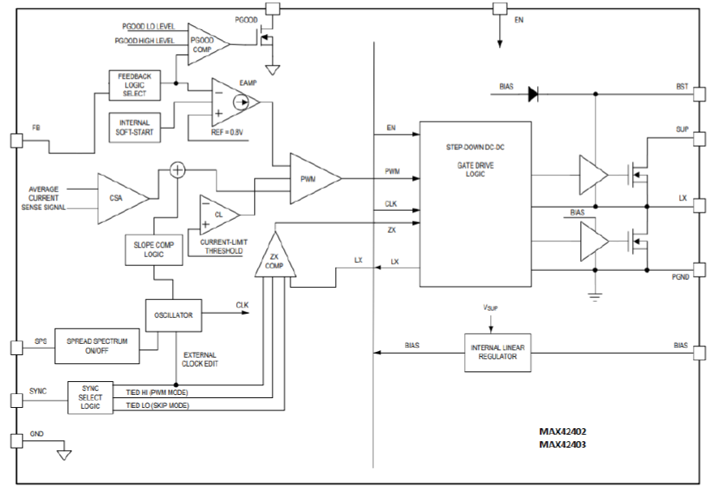
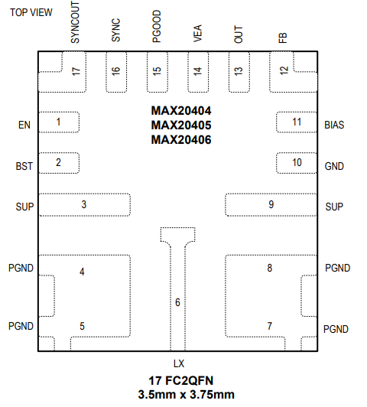
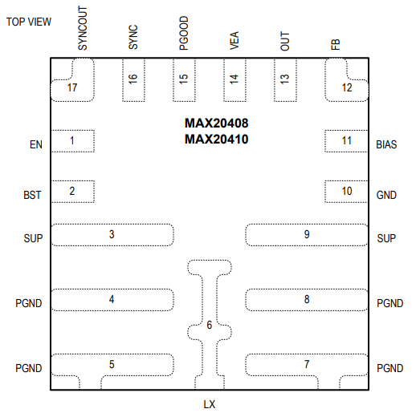
MAX4240x to MAX42410: Value Proposition and Key Benefits
Typical Application Circuit
Value Proposition
Low noise, symmetrical V_{IN} pinouts
High efficiency
Low quiescent current
Block Diagram
Key Benefits
MAX42402
MAX42403
Low EMI solution for applications that require superior EMI performance
Lower loss and better thermal performance at all load ranges with skip mode operation
Portable devices require low power consumption even at standby for extended battery life
MAX42405
MAX42406
MAX42408
MAX42410

Slide 7
MAX4240x to MAX42410: Product Positioning
Features and Specifications
ADI Portfolio Positioning
High efficiency and low I_{Q}
Low noise, spread spectrum for low EMI
MIN on time
Very cost-competitive with high efficiency and low I_{Q} in ADI buck offerings
Very cost-competitive in the silent switcher family of LT parts
Lowest MIN on time
Notes:
This slide shows proof of this product’s strengths.

